Slide 1

GPU-Accelerated Convolutional Kernel Training for vertical edge detection Massimiliano Giordano Orsini

Slide 2
Outlines
01 Project definition and analysis
05 Performance analysis
02 Input and output
06 Usage examples
03 Algorithm description
07 References
04 Implemented routines

Slide 3

Project definition and analysis
Edge detection
process of identifying the boundaries between objects and the background in an image
Finding only vertical edges is a simplification of that task, that
for educational purposes.
Convolutional kernel
It can be learned through a supervised training procedure.
Convolution
$$C\left(i,j\right)= \sum_{l}{\sum_{m}{I\left(i+l, j+m\right)K(l, m)}}$$
cross-correlation, rather than a convolution
It differs slightly from the conventional mathematical definition of convolution
We follow common practice in the machine learning literature

Slide 4
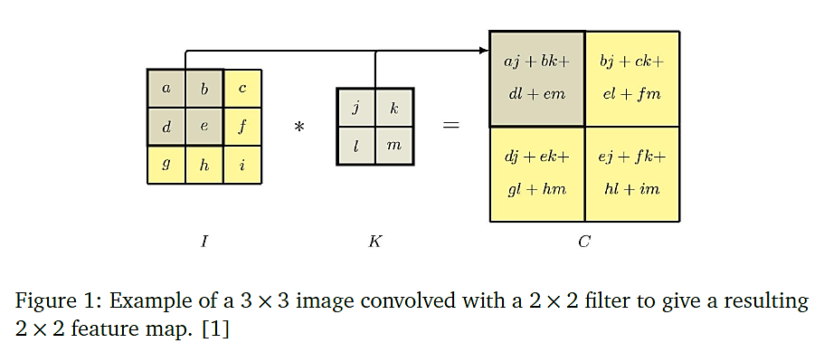
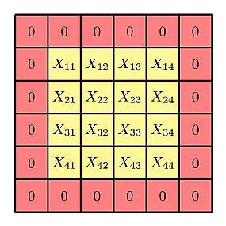


Convolution
Example of convolution
Padding
Padding can be used if we want that the feature map to have the same dimensions as the original image (same convolution).
Feature map: $\left(H+2P −K+1\right)×\left(W+2P−K+1\right)$ where $P= {\left(K−1\right)}/2$
Input image: $H×W$
Kernel: $K×K$
Feature map: $\left(H−K+1\right)×\left(W−K+1\right)$

Slide 5
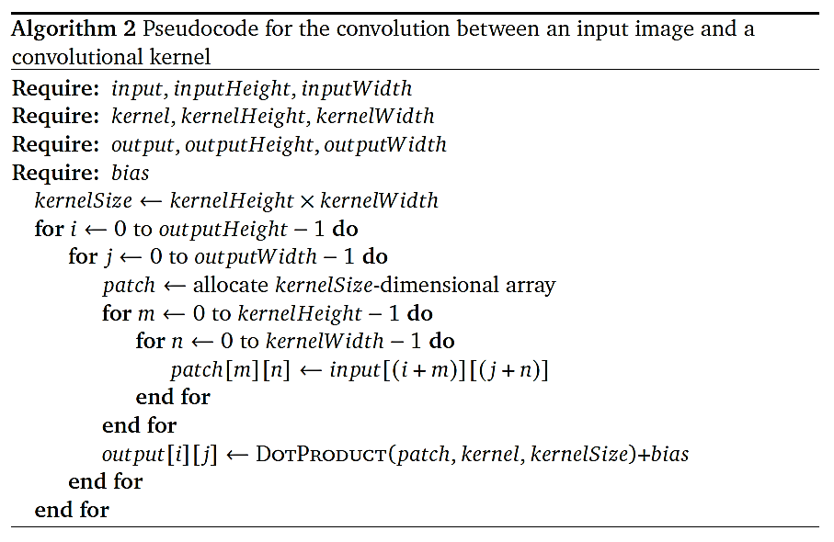
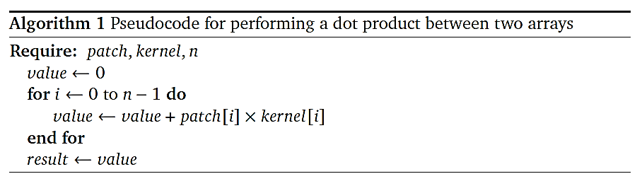


Convolution
Dot product
Sequential algorithm
Convolution can be seen as a particular dot product between a patch of the padded input image and the kernel
Time complexity (no. of operations)
$n$ multiplications
$n−1$ additions
Time complexity (same convolution)
$HWn$ multiplications
$HW\left(n−1\right)+HW$ additions

Slide 6
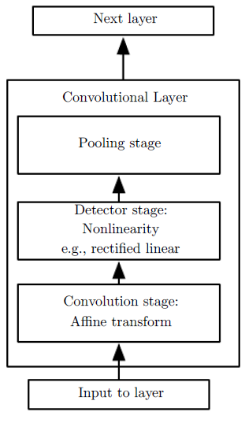
Convolutional Layer
A typical convolutional layer consists of three stages.
In the first stage, the layer performs several convolutions in parallel to produce a set of linear activations.
In the second stage, each linear activation is run through a nonlinear activation function (detector stage).
In the third stage, we use a pooling function to modify the output of the layer further [2]. (pooling stage)
In this work, we do not consider the so-called pooling stage.
The components of a typical convolutional neural network layer

Slide 7
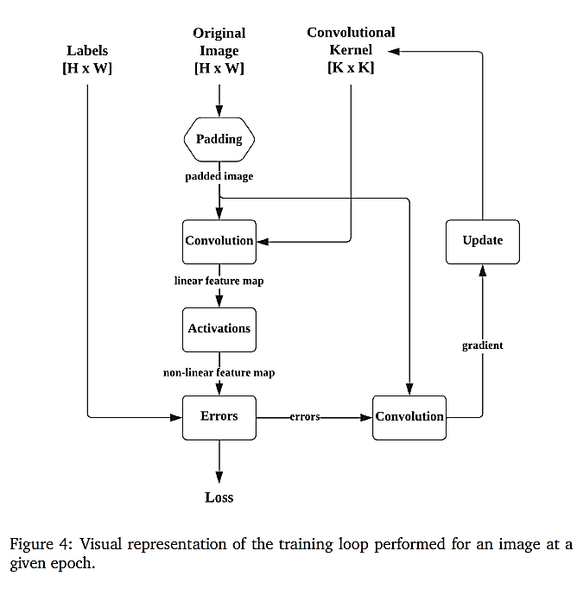

Training
Synthetic dataset
pixels are labeled as edge pixels or not, considering a particular encoding strategy (e.g. 1 for edge pixels, 0 otherwise).
Training/test split
Activation function: sigmoid
$S\left(x\right)= \frac{1}{1+e^{−x}}$
Loss function: MSE Loss
$L=\frac{1}{N}\sum_{i, j}{{\left(t_{i,j}−y_{i,j}\right)}^{2}}$
Gradient descent approach
$w^{′}=w−ε∆_{w}L(w)$

Slide 8
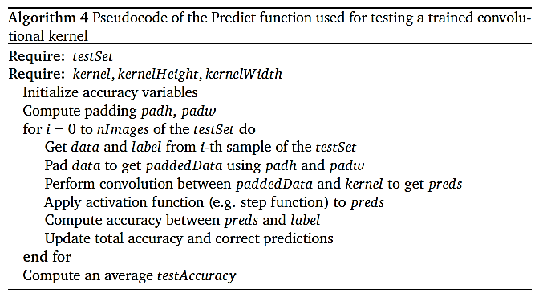
Testing
Evaluation of the trained convolutional kernel on the test set (e.g. pixel accuracy)
Forward pass only
In contrast to the training loop, the step function is used as activation function
Backward pass is avoided

Slide 9
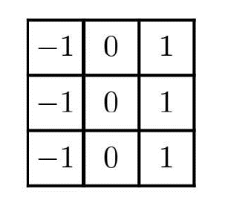

Input and Output
Initialization
Edge columns were chosen randomly when generating the images for the synthetic dataset.
Weights of the kernel can be drawn from some classical distribution (normal, uniform, etc.).
we arbitrarily consider a random initialization by sampling weights from a uniform distribution from 0 to 100.
57
32
98
?
?
?
21
89
26
?
?
?
Input image
LabeledImage
7
11
76
?
?
?
Kernel
negative
positive
Hand-crafted convolutional filter for detecting vertical edges
Labels

Slide 10
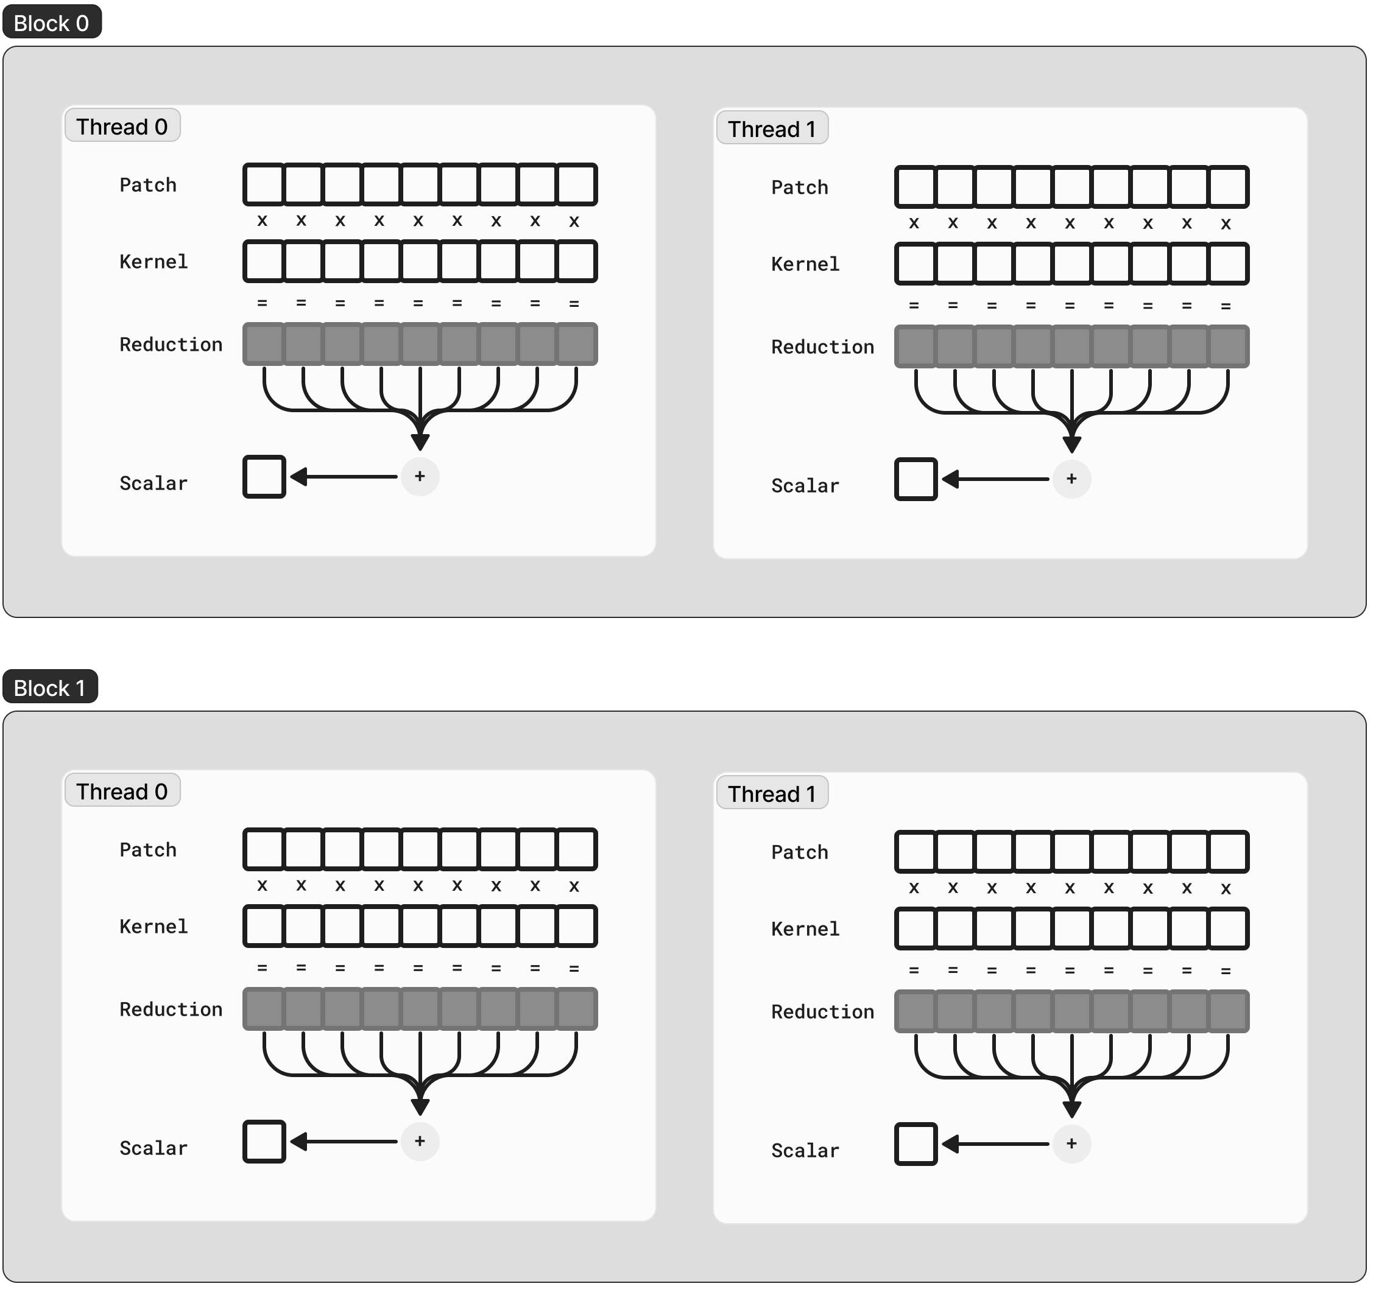
Algorithm description
Number of blocks = height of the output matrix. Number of threads per block = width of the output matrix.
“Each thread in the grid is responsible for computing one element of the output matrix, independently, according to the coalescence rules.”
Note that, at the forward pass, the size of the output matrix is equal to the size of the input image, while at the backward pass, it is equal to the size of the kernel.
This is the reason why shared memory is not involved in this strategy, on a single GPU.

Slide 11
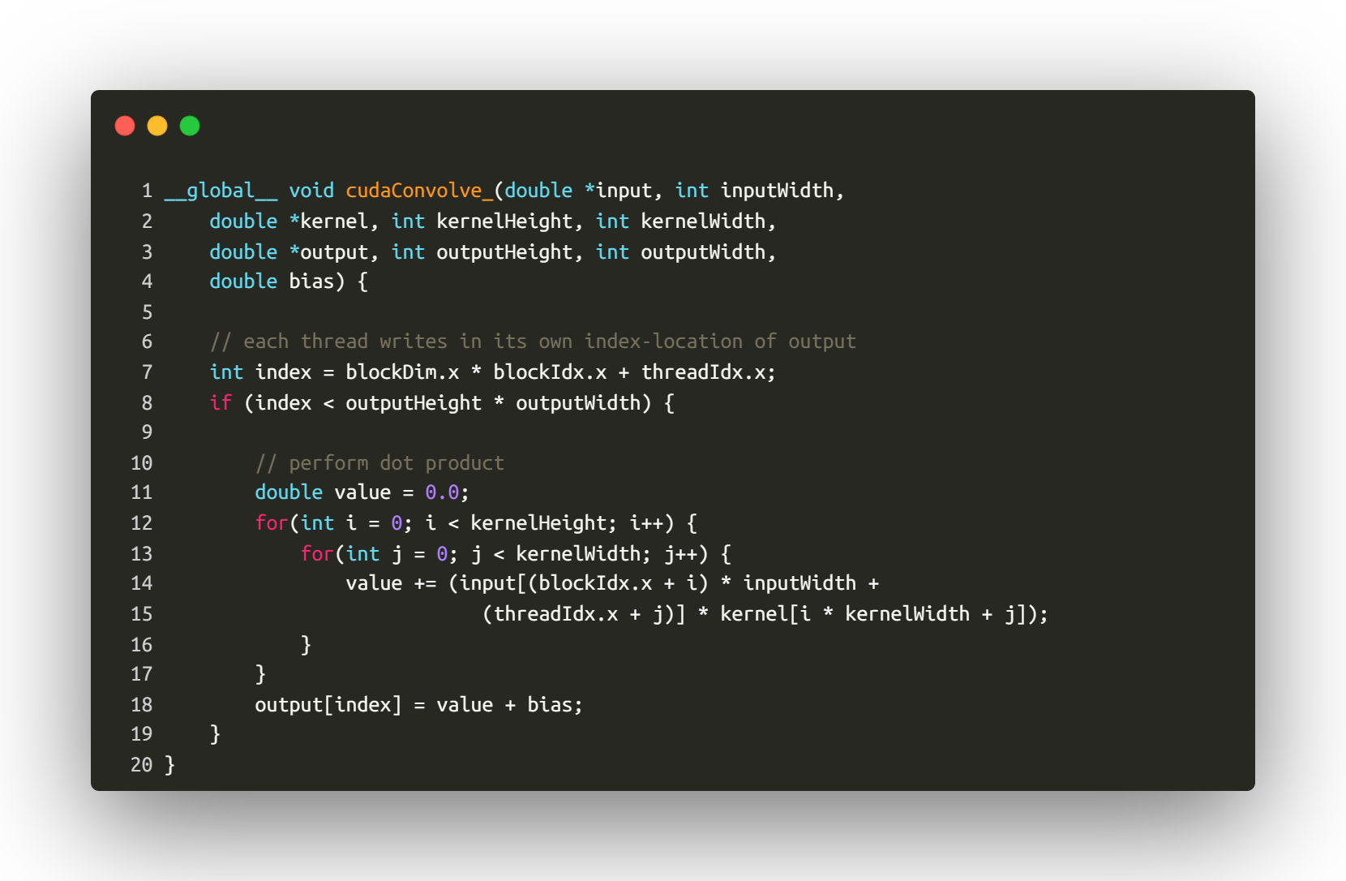
cudaConvolve_
Implemented routines
Performs the dot product between input, which is a patch of the padded input image, and the kernel. Then, the bias is added.
The result is stored in output.
This code is executed by each thread, independently.

Slide 12
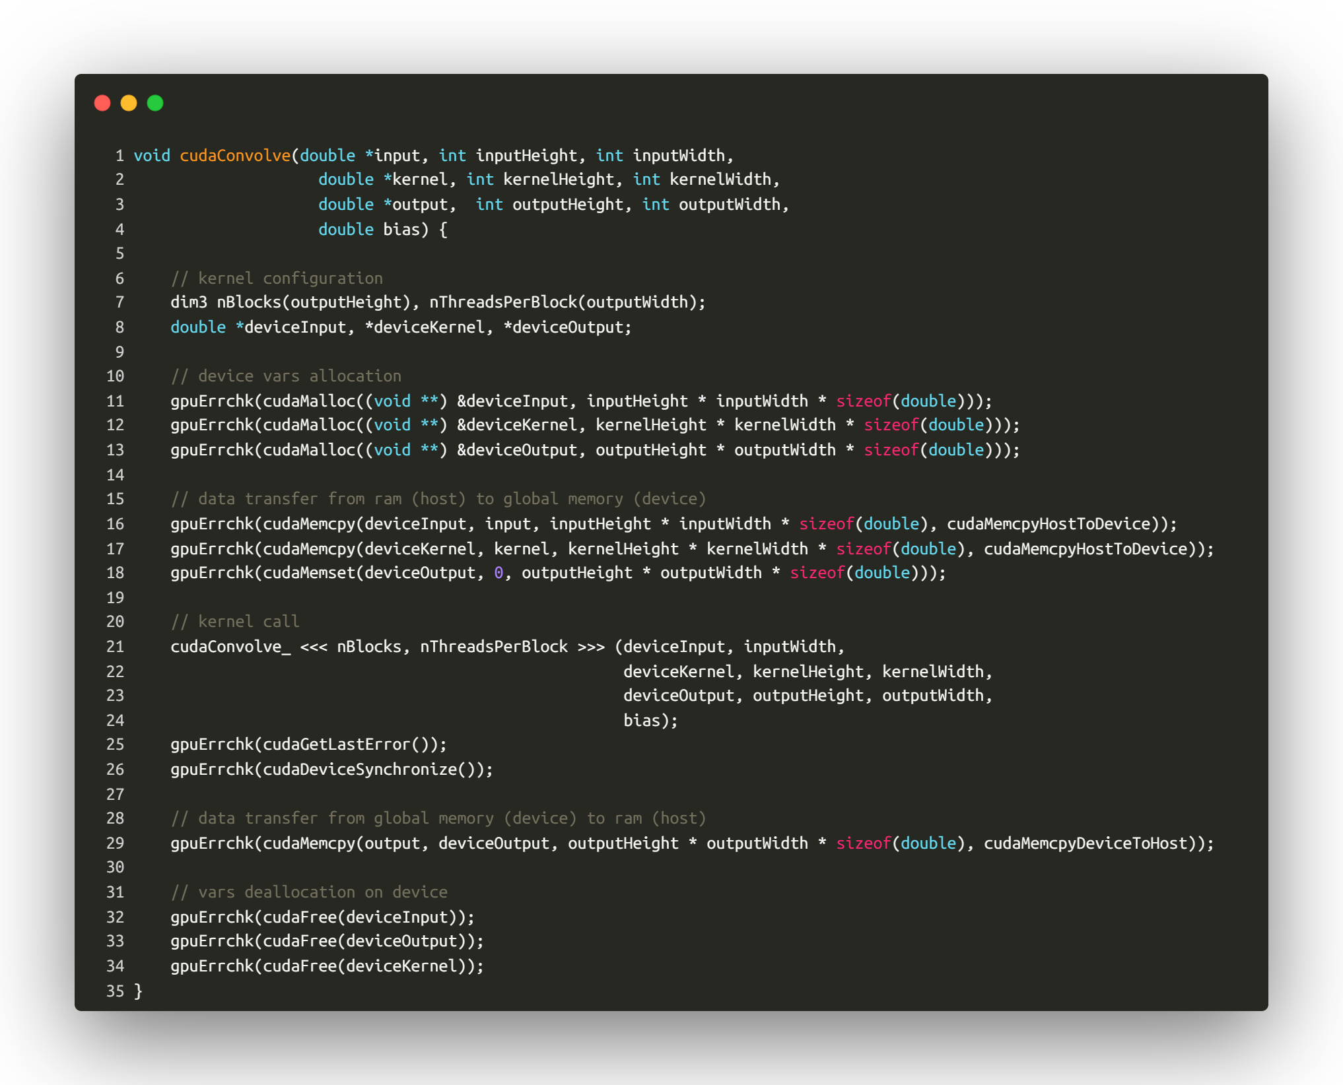
cudaConvolve
Implemented routines
Performs the convolution between the input image and the kernel. Then, the corresponding feature map is stored in output.
gpuErrchk is a macro defined for checking any possible error produced by CUDA routines, ensuring the consistency of their output.

Slide 13
Performance analysis
All the experiments were performed on PurpleJeans
All the experiments were conducted under the same initial conditions, which are:
Dataset: 500 squared images pixel-labelled
Training/test split: 75/25, learning rate: 0.1, no. of epochs: 10.
Same initialization of the convolutional kernels, which were squared and generally odd.
Almost all the experiments reported a loss value between 0 and 1 in the last epoch of the training phase and a 100% accuracy score at the testing phase, except for some of them, which in anyway reached a 99.8% accuracy score.
However, these results were omitted from our analysis because we are focused on the capabilities of the proposed parallelization strategy

Slide 14
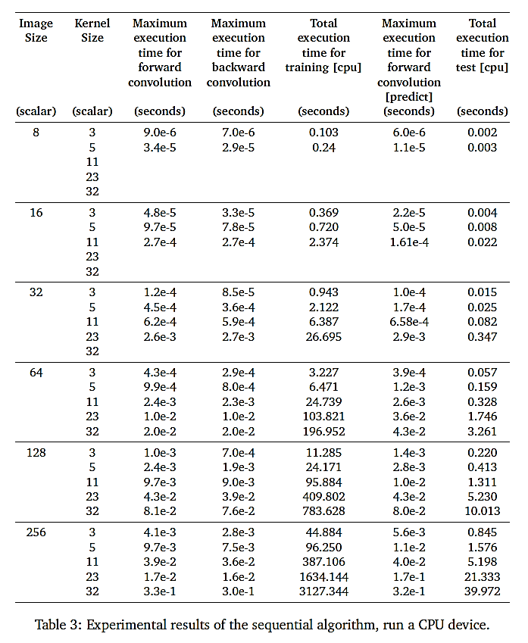
Performance analysis: sequential algorithm
Table 3 reports the experimental results of the sequential algorithm.
Execution times seem to be quite reasonable for little computational kernel.
Performances start to degrade quite faster considering larger and larger kernels and images, as we expected.

Slide 15
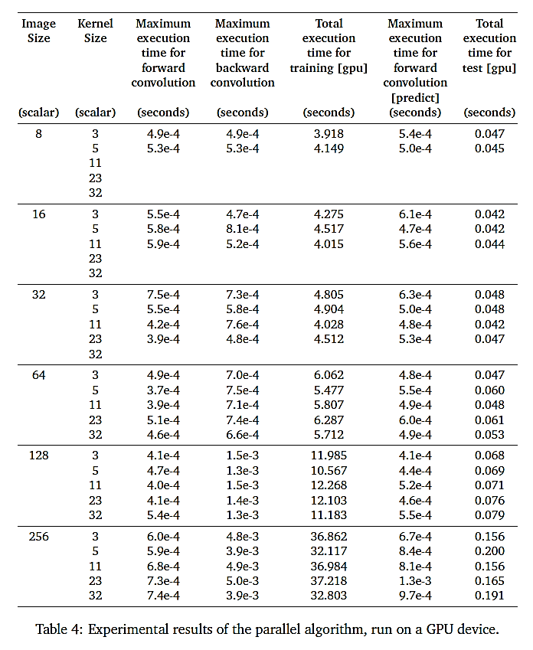
Performance analysis: parallel algorithm
Table 4 shows the experimental results of the parallelization strategy.
For little computational kernels, performances are even worse than the sequential version (mainly, due to the communication overhead) but quite consistent, also considering huge image and kernel sizes.
Execution times measured for forward convolutions seem to be almost constant, in contrast to what we’ve seen before.

Slide 16
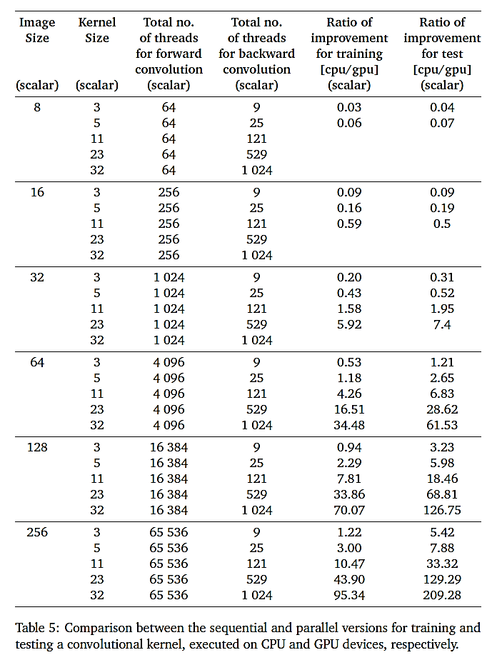
Performance analysis: ratio of improvement
Table 5 highlights
the number of threads involved in the computation of the forward and backward convolutions
improvement obtained by using the proposed parallel algorithm
The overall training and testing phases result to be up to 95 times and 209 times faster, respectively, in comparison to what we measured initially.

Slide 17
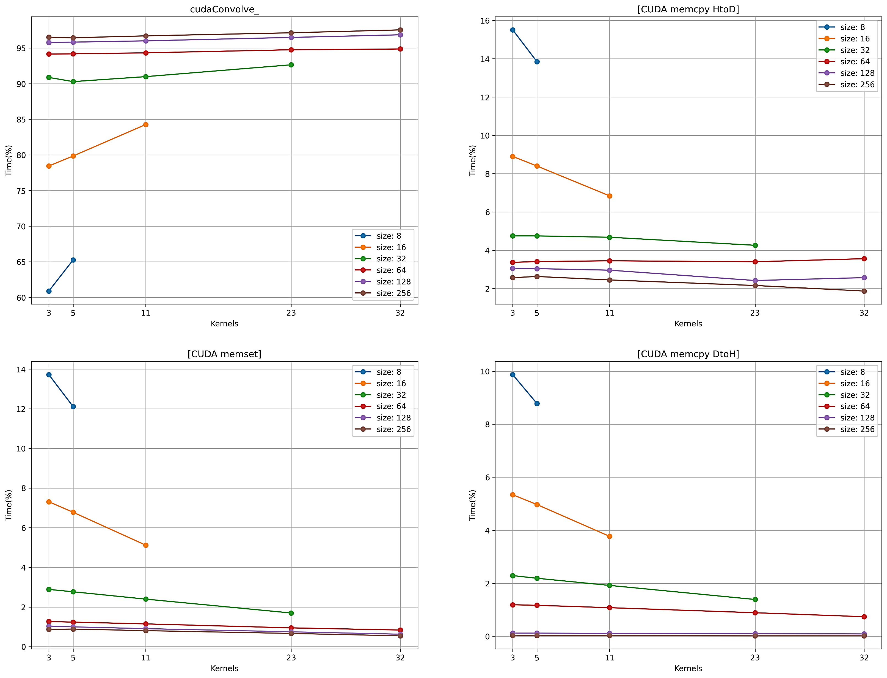
Performance analysis: profiling
nvprof enables the collection of a timeline of CUDA-related activities on both CPU and GPU.
We used the option –print-gpu-summary, which prints a summary of the activities on the GPU (including CUDA kernels and memcpy’s/memset’s).
The total number of calls for cudaConvolve_, CUDA memset, CUDA memcpy DtoH is 10125, while for CUDA memcpy HtoD is 20250.
Most of the execution time is spent on cudaConvolve_ function, and its time percentage increases with the size of the kernel.

Slide 18
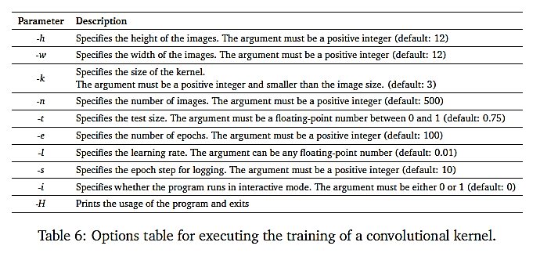
Usage examples: options
Table 6 resumes the options, in common between all the files, for tweaking the hyperparameters of
the training.

Slide 19
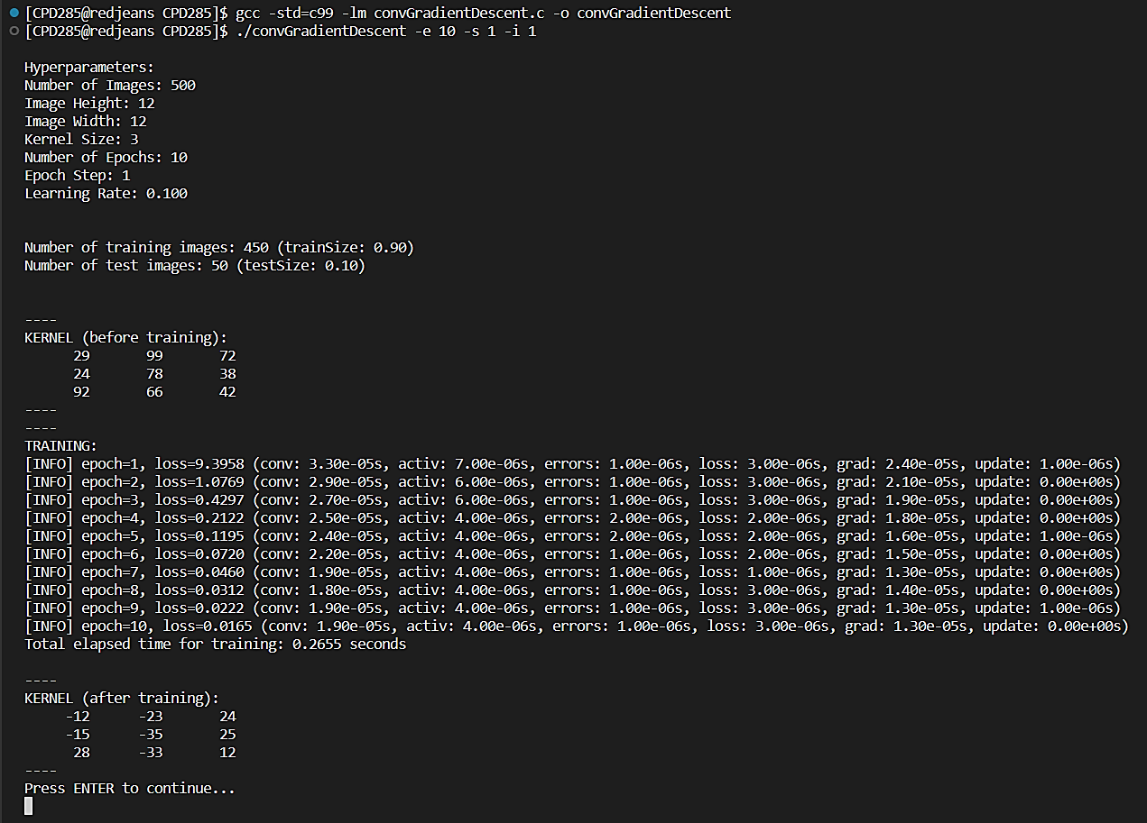
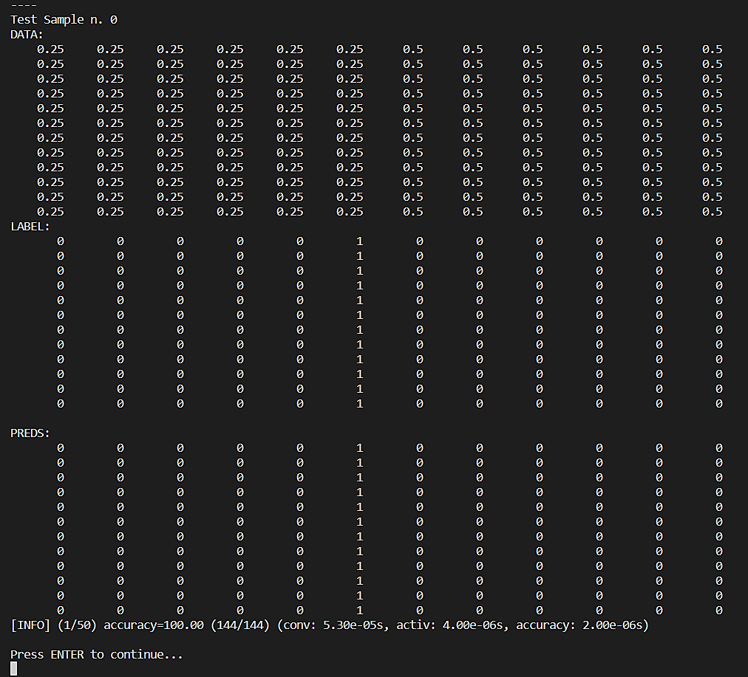
Usage examples: convGradientDescent.c

Slide 20
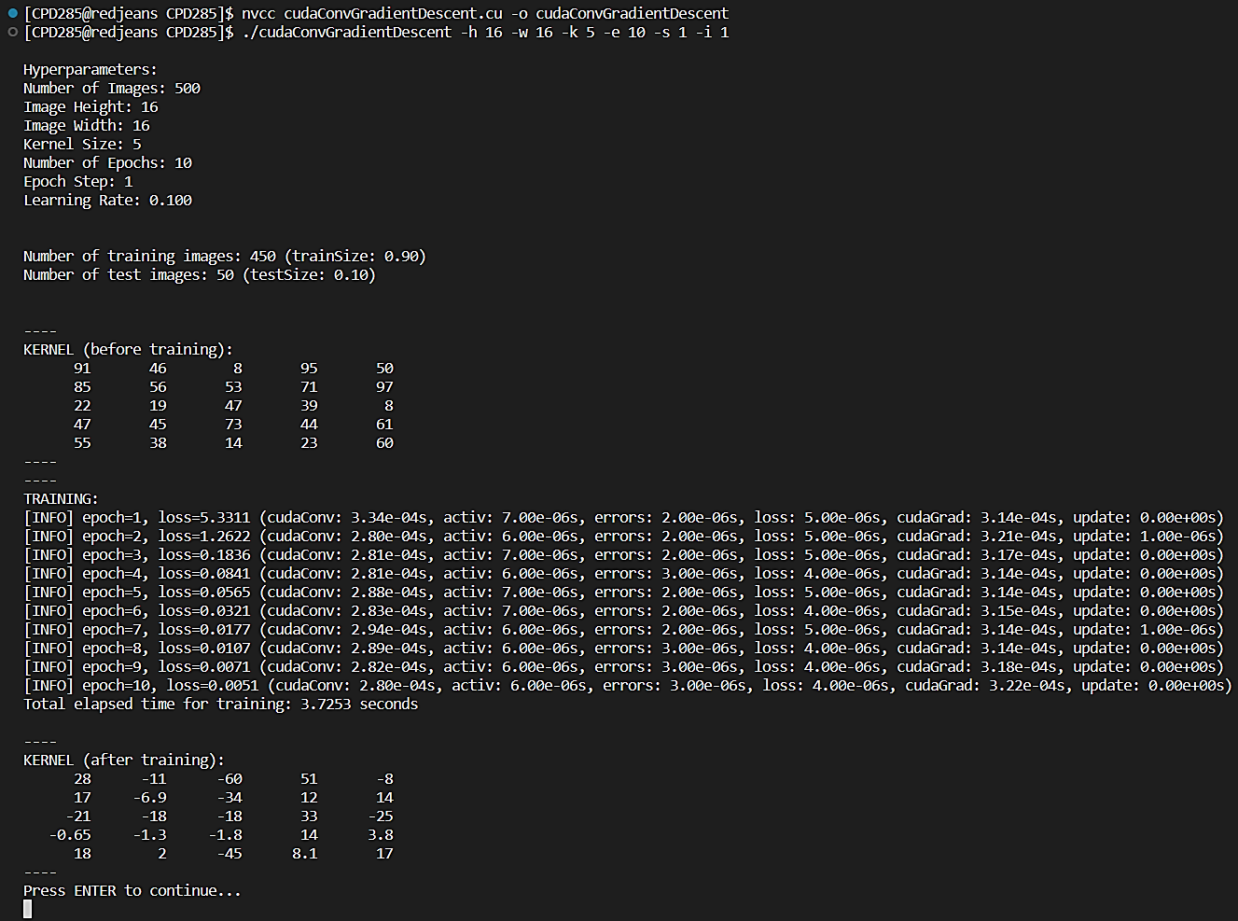
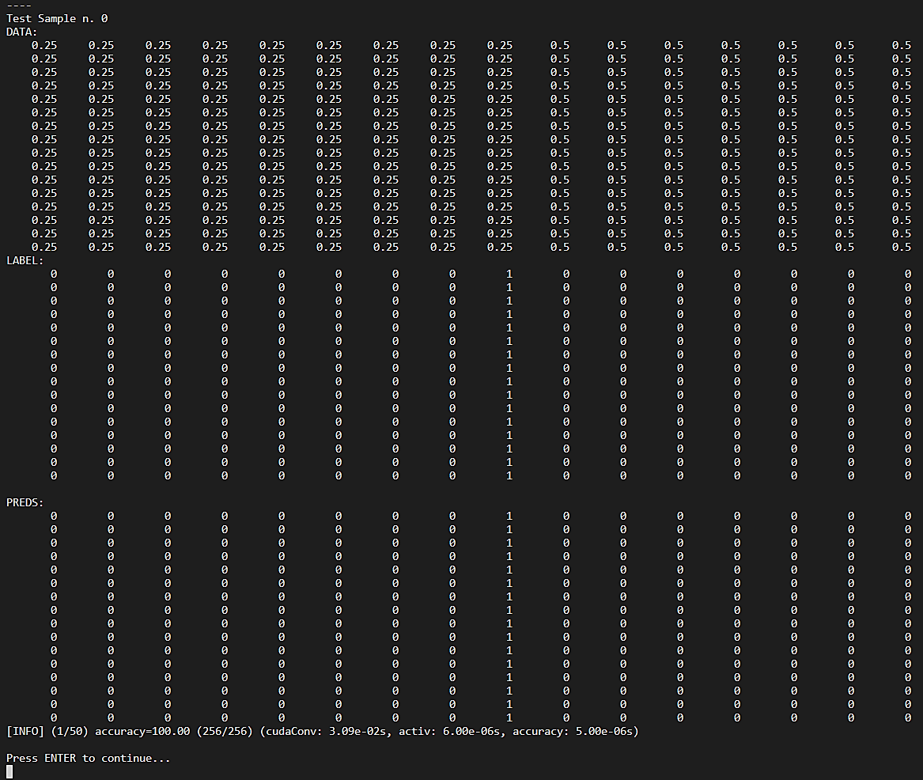
Usage examples: cudaConvGradientDescent.cu

Slide 21
References
Christopher M. Bishop and Hugh Bishop. Deep Learning: Foundations and Concepts. Springer International, 2024
Ian Goodfellow, Yoshua Bengio, and Aaron Courville. Deep Learning. MIT Press, 2016
Alessio Ferone. “Computer Vision - Recognition” (Slides of the lecture).
Research Computing Facilities. Research Computing Facilities. url: https://rcf.uniparthenope.it/en/about/
Research Computing Facilities. Research Computing Facilities. url: https://rcf.uniparthenope.it/en/resources/

